Slide 1
Sun Safety at Work Canada
Solar UV Exposure Training for Employees
Notes:
This presentation is for outdoor workers. It is designed to be presented by supervisors or health and safety practitioners. It provides an overview on: what is solar UV, skin cancer and eye conditions associated with solar UV exposure, and basic approaches used to manage solar UV exposure of outdoor workers.

Slide 2
Purpose of this Training
The objective of this training is to provide basic information for workers about solar UV exposure and how to protect themselves from this hazard.
The content will explore:
  The hazard posed by Solar UV
  The health effects of exposure to Solar UV
  The extent of the problem
  Facts related to UV safety
  Methods to protect employees from exposure to Solar UV
Notes:
When delivering this presentation, please review/discuss the objective and content

Slide 3
What is Solar UV?
UV is short for Ultraviolet Radiation.
Solar UV part of the spectrum of radiation that is contained in the energy from the sun that reaches the earth.
Some of this radiation is in the form of visible light. Visible light is what our eyes use for sight, to perceive shape and colour.
UV rays are invisible. Their energy is stronger than visible light and weaker than x-rays.
Notes:
This slide is intended to describe what ultraviolet (UV) radiation is and to show the relative energy level of UV. This is so participants can gain an understanding that the energy of UV is just below the level of x-rays (which most people would immediately identify as being dangerous) and above visible light, which participants are familiar with. This is further explained diagrammatically in the next slide.

Slide 4
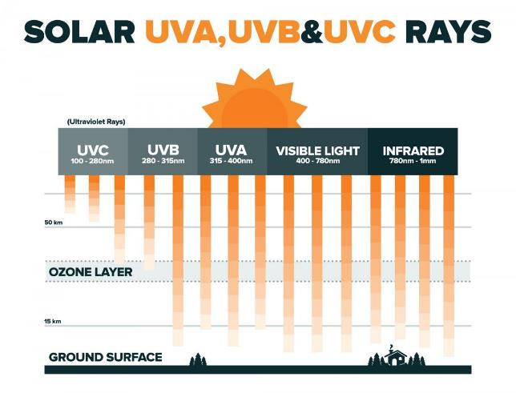
Notes:
This slide describes the wavelengths of UV, visible and infrared radiation. All of these are emitted by the sun. As wavelength increases (gets longer), energy levels and the potential to cause biological damage in humans decreases. As UV has the shortest wavelengths, it has the highest energy of these types of radiation from the sun. As such, it has the potential to cause the most damage to our skin and eyes.
This slide also shows that UV wavelengths below 290 nanometers are blocked/filtered out by the ozone layer. This means that outdoor workers are being exposed to the longer wavelengths of UV, i.e. UVB and UVA. However, these wavelengths have sufficient energy to cause skin cancer and eye conditions, particularly UVB.
The shorter wavelengths of UV, i.e. UVC and UVB below 290nm are generated by a range of sources, such as welding arcs and various lighting systems. As such, if outdoor workers are also exposed to welding, they will also be receiving much more UV exposure.

Slide 5
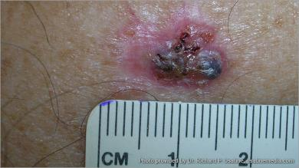
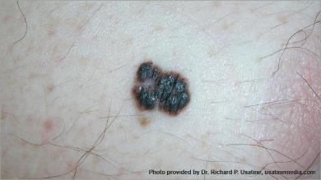
Sun Exposure and Your Skin
Exposure to UV from the sun can lead to:
  Skin cancer: basal cell carcinoma, squamous cell carcinoma (together referred to as non-melanoma skin cancer) and melanoma
  Sunburn
  Skin damage
Notes on Images:
Top photo = basal cell carcinoma; Bottom photo = melanoma
Photo source: http://www.cancer.org/cancer/skincancer/galleries/skin-cancer-images
Notes:
The mechanism for these health effects are the impact of UV energy (as made understood in the previous slide) on skin cells which over time (considering duration, frequency and intensity of exposure) cause changes to cellular structure. These changes in cellular structure result in the cancers described in this slide.

Slide 6
Facts About Skin Cancer
UV from the sun is the primary cause of skin cancer
Types of skin cancer:
  Squamous cell carcinoma and basal cell carcinoma, together referred to as non-melanoma skin cancers
  Melanoma
Notes:
This slide is intended to convey the extent of the health problem in order to emphasize the importance of preventing exposure/over-exposure to UV.

Slide 7
Facts About Skin Cancer
Skin cancer is the most commonly diagnosed cancer in Canada and rates are increasing.
  Around 80,000 new cases of non-melanoma skin cancers and 7,000 cases of melanoma each year. 1 in 3 cancers is a skin cancer.¹
Outdoor workers are up to 2.5 to 3.5 times more likely to be diagnosed with skin cancers.²
Skin cancer is largely preventable.
Notes:
This slide is intended to convey the extent of the health problem in order to emphasize the importance of preventing exposure/over-exposure to UV.

Slide 8
Health Outcomes of Skin Cancer
Even if identified early, skin cancer often requires surgery and leaves permanent scarring.
The average melanoma patient loses 28 days of work per diagnosis.³
Over 1,200 Canadians die from melanoma skin cancer each year, and rates are rising.¹
Notes:
This slide highlights personal health effects of skin cancer and is intended to convey the importance of preventing exposure/over-exposure to UV

Slide 9
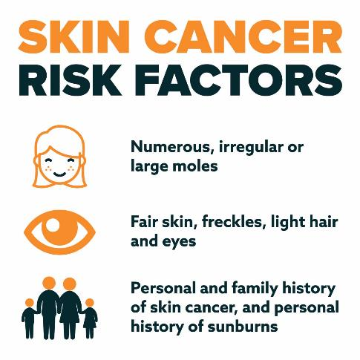
Notes:
We each have personal traits which may increase our risk of getting skin cancer. The factors listed in this slide are those which are known to be related to an increased risk for skin cancer.

Slide 10
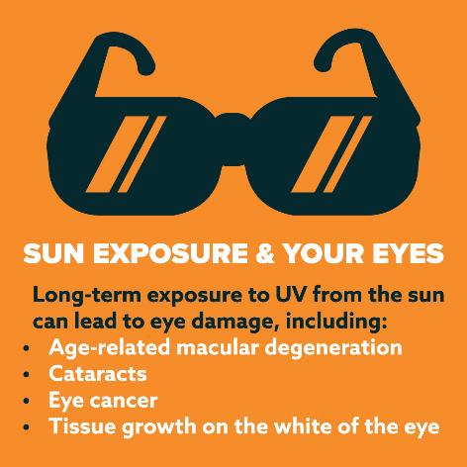
Notes:
Sun exposure can lead to a range of eye conditions. An acute condition, photokeratitis (also known as welder flash, or snow blindness) is associated with short-term exposure to high levels of UV. For outdoor workers, they are most vulnerable to photokeratitis during winter when there is a lot of reflected UV off snow, or when they are working around highly reflective surfaces (e.g. water, sand, metal roofing).
In addition to short-term/acute effects, long-term exposure to high levels of solar UV is associated with developing a number of eye conditions. These include:
Age Related Macular Degeneration – a disease in which the detectors of light and colour in our eyes become burned out.
Cataracts – a disease which clouds the retina causing blindness over time, resulting in the gradual onset of symptoms.
To protect the eyes, wear a hat with a brim and sunglasses (which provide at least 99 per cent UV protection) year-round to reduce exposure to the sun’s harmful rays, which can damage the retina.

Slide 11
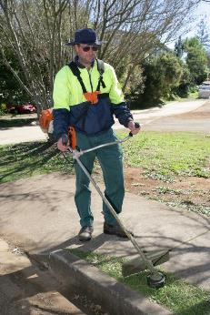
Occupational UV Exposure
Of the 1.5 million outdoor workers in Canada, about 900,000 are outside at least 6 hours a day.⁴
Outdoor workers often work when the sun is the strongest.
Spending lunch and breaks out of the sun can have a significant impact on lowering your exposure.
The months of concern in Canada for high UV exposure are April to September, but winter months also hold risk due to reflection and glare from snow.
Image provided by Queensland Department of Health
Notes:
In this slide we are highlighting key facts about occupational solar UV exposure to further emphasize the nature/extent of the issue and to also provide tips on how to lower exposure.

Slide 12
Notes:
The UV Index is a simple measure for describing the level of solar UV radiation being received at a particular location. It varies throughout the day and through the year. Throughout a day, the UV Index peaks between 11am and 3pm. Throughout the year in Canada, the UV Index is generally above 3 between March and October, and is often above 8 between June and August.
Based on the UV Index for the day, different levels of protection are recommended.
We recommend that a supervisor monitor/be aware of the UV Index for each day and implement appropriate protection measures.

Slide 13

Facts About Tanning
No matter how dark your skin is, everyone is at risk of sunburns and skin cancer.
A tan is an indication of skin damage. Even with a tan you can get sunburnt and any sun exposure contributes to long term skin damage.
A tan does not provide protection against skin damage.
Image provided by Queensland Department of Health
Notes:
The purpose of this slide is to briefly discuss some misconceptions regarding tanning and sunburn.
Darker skin does provide some protection (in comparison to fair skin), but UV is still striking the skin and this exposure is what we need to reduce. Another way to say this is that darker skin in no way reduces the amount of UV striking the skin.

Slide 14
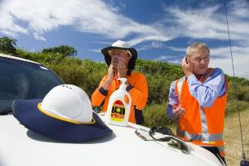
Facts about Sunscreen (1)
Sunscreen is effective when applied correctly. Use a sunscreen that is SPF 30, broad spectrum and water-resistant.
Sunscreen should be used in combination with other controls (long clothing, hats, shade, sunglasses).
Apply generously and use more than you think you need. Reapply regularly.
Sunscreen begins to work as soon as you apply it. Use sunscreen as part of your preparation for the day, just like brushing your teeth.
Image provided by Queensland Department of Health
Notes:
The purpose of this slide is to briefly discuss some misconceptions regarding sunscreen and to discuss the ways in which sunscreen can be used to ensure that it provides the greatest level of protection possible.
You may wish to acknowledge that there are other safety concerns for clothing types (rotating equipment, electrical) but once these are met, neutral colours and good ventilation make for good UV protective clothing while balancing heat.

Slide 15
Facts about Sunscreen (2)
Sunscreen ingredients are tested and must follow health guidelines to make sure they are safe to use.
Store sunscreen in a cool place as it can deteriorate if stored in hot conditions.
You can use sunscreen and bug repellant together. Apply sunscreen first before applying insect repellent. You should reapply sunscreen as needed, and more often if you’ve been in the water or sweating, while insect repellent may last for several hours.
Notes:
Some advocacy groups claim that certain chemicals in sunscreens are harmful and may increase your risk of developing cancer, however none of these chemicals (oxybenzone, retinyl pamitate and parabens) have been found to pose a cancer risk.
Some people may be sensitive to some sunscreens, so test a small amount before use.
Using insect repellant on-top of sunscreen does not impact the effectiveness of the sunscreen to any great extent while providing for protection against insects.

Slide 16
Vitamin D
The sun is not the only source of Vitamin D.
Vitamin D can be obtained safely from foods like dairy products, fatty fish, fortified foods and/or supplements.
Intentional sun exposure to meet vitamin D requirements is not recommended.
Notes:
Our need to have sufficient levels of vitamin D in our bodies is an important for a range of conditions, including having strong bones.
Exposure to solar UV is an effective way to produce vitamin D. However, the risk of skin cancer from high levels of sun exposure has to be weighted against the risks of potentially lower levels of vitamin D.
Because vitamin D is available through various foods and through supplements and tablets, intentional sun exposure for the purpose of producing vitamin D is not recommended.
For many people, the incidental sun exposure they receive while travelling to work and over lunchtime etc should be sufficient for vitamin D production and so additional sun exposure through outdoor work activities or through sunbathing is not generally recommended.

Slide 17
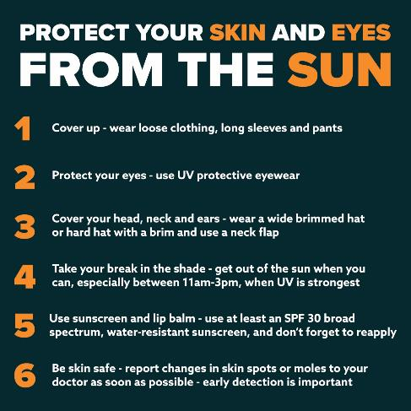
Protection Measures You Can Take
Notes:
The actions/measures listed are designed for workers to take to help protect themselves from solar UV exposure.
Cover up – wear loose clothing, long sleeves and pants to keep the sun off your skin
Protect your eyes - use UV protective eyewear
Cover your head, neck and ears – wear a wide brimmed hat or a hard hat with a brim and use a neck flap
Take your breaks in the shade – get out of the sun when you can, especially between 11am-3pm, when UV is the strongest
Use sunscreen and lip balm – use at least an SPF 30 broad spectrum, water-resistant sunscreen and don’t forget to reapply
Be skin safe – report change in skin spots and moles to your doctor as soon as possible – early detection is importan

Slide 18
References
Canadian Cancer Society’s Advisory Committee on Cancer Statistics. (2014). Cancer Statistics 2014. Toronto, ON: Canadian Cancer Society.
Radespiel-Tröger, M., Meyer, M., Pfahlberg, A., Lausen, B., Uter, W., and Gefeller, O. (2009). Outdoor work and skin cancer incidence: a registry-based study in Bavaria. Int Arch Occup Environ Health, 82, 357–36.
Canadian Partnership Against Cancer. (2010, Feb 26). The Economic Burden of Skin Cancer in Canada: Current and Projected. Retrieved from http://www.cancercare.ns.ca/site-cc/media/cancercare/Economic%20Burden%20of%20Skin%20Cancer%20in%20Canada%20Report.pdf
Peters, C. E., Nicol, A. M., Demers, P. A. (2012). Prevalence of exposure to solar ultraviolet radiation (UVR) on the job in Canada. Can J Public Health, 103(3), 223-226.

Slide 19










Thank you!
Production of this presentation has been made possible through financial support from Health Canada through the Canadian Partnership Against Cancer.
Thank you to all of the partners who made this project a success:

