Slide 1
Sun Safety at Work Canada
Heat Stress Training for Supervisors
Notes:
This presentation is for supervisors of outdoor workers. It provides an overview on: what is heat stress is, the signs and symptoms of heat stress, approaches used to manage heat stress of outdoor workers, and resources available from the Sun Safety at Work Canada project.

Slide 2
Purpose of this Training
The objective of this training is to provide basic information for supervisors about heat stress from outdoor work and how to protect employees from this hazard.
This presentation will cover:
The hazard posed by heat stress and outdoor work
The health effects of heat stress
First aid in case of heat stress
Methods to protect employees from heat stress
Notes:
When delivering this presentation, please review/discuss the objective and content

Slide 3
Heat Stress is a Big Deal
Heat stress happens when your body loses its ability to self-regulate body temperature.
Heat stress can lead to a range of heat-induced conditions (from least serious to most serious): heat rash, heat cramps, fainting, heat exhaustion, heat stroke.
For outdoor workers, the sun is the biggest cause of heat stress. They are at a much higher risk of heat stress (for example, agricultural workers in the USA are at 20 times the risk than the national rate¹)
Notes:
Discuss the response of the body when exposed to excessive heat: when we are exposed to excessive heat and often in combination with physical activity, the normal internal body temperature can not be maintained and body temperature rises. This causes heat stress on the body which can lead to a range of health conditions, many which are serious.

Slide 4
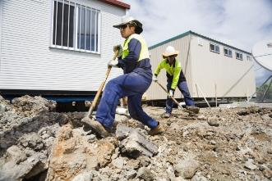
Serious Outcomes of Heat Stress
Heat illness caused by heat stress can be a matter of life and death. Workers die from heat stroke every summer and every death is preventable.
When heat stroke doesn’t kill immediately, it can shut down major body organs causing acute heart, liver, kidney and muscle damage, nervous system problems, and blood disorders.
Image provided by Queensland Department of Health
Notes:
It is important to note that a number of heat illnesses/conditions are very serious, particularly heat stroke. Permanent injury can result. Some will die and for others they will never be the same.
Emphasize the role of supervisors in maintaining the health and safety of employees.

Slide 5
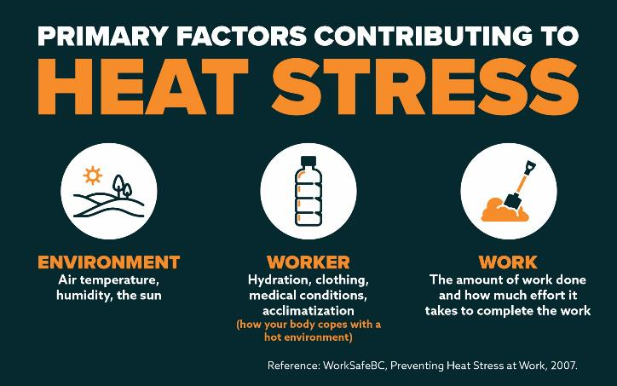
Notes:
Following on from the previous slide of emphasizing the role of supervisors. This slide discusses the primary factors which contribute to heat stress.
Supervisors have a role in monitoring each of the primary factors for heat stress and putting in-place front-line strategies for control.
One of the ways to recognize conditions is to monitor not only the atmospheric conditions (e.g. temperature and humidity; humidex) but also how employees are responding to hot work conditions. A worker who is overheating exhibits signs that can be recognized by those around them.
A Supervisor should pay close attention to work intensity as heat stress risks climb. There are ways to do this which we shall examine later.

Slide 6
Temperature, Humidity and Body Cooling
Humans perspire as a means of cooling the body.
The higher the relative humidity, the less perspiration can be evaporated, reducing the cooling effect of evaporation and increasing heat load in the body.
The combination of rising temperature and work demands can lead to heat stress situations for workers.
Notes:
This slide describes one of the major body responses to heat: perspiration. The resulting evaporation of perspiration is the mechanism by which cooling takes place. When high humidity levels interfere with the efficiency of evaporation, cooling is not as effective as the worker may need to maintain a proper core body temperature.

Slide 7
Humidex
The humidex is a Canadian invention and is a measure of how hot we feel. It is based on the combined effects of high temperature and humidity.
Very high humidex values are generally rare in Canada.
Notes:
Humidex is a measure of the environmental conditions which contribute to heat stress. It is a measure which describes the combined effects of temperature and humidity.
Monitoring humidex values and taking specific actions in response to increasing humidex values is an important risk management approach for heat stress of outdoor workers.

Slide 8
Heat Illness
Heat illness has a range of outcomes, each being more severe.
With the initial onset of symptoms, the worker may feel tired or fatigued and perhaps a little disoriented.
If no action is taken to address the heat stress, more severe stages of heat illness develop – this can be life threatening.
Heat rash → Heat cramps → Fainting → Heat exhaustion → Heat stroke
Notes:
Recognizing, interrupting and reversing the progression of heat stress is the goal.

Slide 9
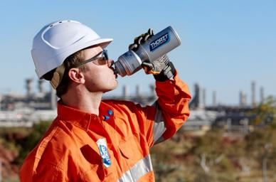
Onset of Heat Stress
Symptoms:
General feeling of tiredness or fatigue
First Aid:
Fluid replacement and rest
(Image source: http://www.srmi.com.au/images/thorzt3.jpg)
Notes:
At this stage getting out of the heat and monitoring how the worker feels in terms of recovery is a good step
The next series of slides discuss the progression of heat stress conditions from the least serious to the most serious. For each, the signs ad symptoms will be described along with basic first aid measures.
For all conditions, basic first aid involves getting the affected person out of the sun and into a shaded area, removing clothing, cooling them down by fanning (if appropriate), lying down and rehydrating (through sips of water).

Slide 10
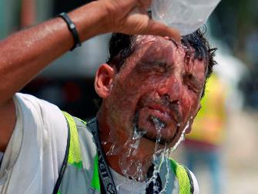
Heat Rash
Symptoms:
Skin becomes reddened and may itch, feel prickly or hurt
Red bumpy rash with severe itching
First Aid:
Avoid hot environments
Rinse skin with cool water
(Image source: http://blogsdir.cms.rrcdn.com/91/files/2014/08/june_heat_15.jpg)

Slide 11
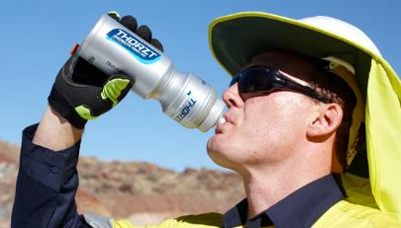
Heat Cramps
Symptoms:
Cramping of muscles (often in arms, legs or stomach)
First Aid:
Move to cool area
Loosen clothing
Massage and stretch cramping muscles
Drink cool water (salted or electrolyte replacement)
(Image source: http://thorzt.com/wp-content/uploads/2014/01/Safety-Tips-for-Working-in-the-Heat.jpg)

Slide 12
Fainting
Symptoms:
Sudden fainting after at least 2 hours of work
Cool moist skin, weak pulse
First Aid:
Assess need for CPR
Move to a cool area
Loosen clothing
Have the person lie down
Offer sips of cool water

Slide 13
Heat Exhaustion
Symptoms:
Heavy sweating
Cool moist skin
High body temperature
Weak pulse
Normal or low blood pressure
Tired and weak
Nausea and vomiting
Very thirsty
Panting or breathing rapidly
Blurry vision
First Aid:
GET MEDICAL ATTENTION
Move worker to a cool shaded area
Loosen or remove excess clothing
Provide cool water to drink
Fan and spray with cool water
Do not leave them alone
Notes:
It is important to emphasize the need for medical attention if someone is exhibiting the signs and symptoms of heat exhaustion.
Also, someone may not know that they are showing the signs of heat exhaustion and so it is important to keep an eye on work colleagues.

Slide 14
Heat Stroke
Symptoms:
Weak, confused, upset, acting strangely
Hot, dry red skin
Profuse sweating
Fast pulse
Headache or dizziness
In late stage, may pass out and have convulsions. This condition is very serious and can kill quickly.
First Aid:
CALL AN AMBULENCE
Remove excess clothing
Fan and spray with cool water
Offer sips of water if worker is conscious
Notes:
Heat stroke is very serious and is life threatening. Emergency assistance is needed in the case of a worker exhibiting the signs of heat stroke.
Obviously the goal of heat stress prevention training and protection measures is to not have heat stroke.

Slide 15
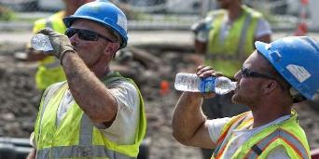
Other Health Risks to Workers
Increased Accidents: tired, fatigued workers are more susceptible to accident and injury.
Heart/Lung Strain: heat stress places additional strain on the heart and lungs. This strain is enhanced with dehydration. Workers who have heart, lung, kidney or circulatory problems are at additional risk.
(Image source: http://esub.com/wp-content/uploads/2016/03/constructions-workers-drinking-water.jpg)
Notes:
This slide points to the required due diligence of the Employer and duty of the Supervisor to protect workers.
It also leads participants to think about individual workers and potentially tailoring their work to accommodate pre existing conditions which raise the level of risk.

Slide 16
Acclimatization
Acclimatization is the ability of our body to adapt to working in a hot environment.
Initial benefits occur within a few days. Longer-term benefits take a few weeks of exposure in a hot environment.
Acclimatization can be lost quickly (for example, over a long weekend). Loss of acclimatization due to short absences (2 days or less) can be made-up quickly, but longer absences take up to a week to be made-up.
Often, outdoor workers are considered not to be acclimatized because they don’t work at higher enough temperatures for long enough.
Notes:
Acclimatization of individuals does occur and there are benefits for the person regarding their ability to cope with higher heat conditions. However, it does not last. Also, to become acclimatized, workers need to work over a reasonable period of time (a few weeks) at consistently high temperatures. As such, all workers should be considered to be unacclimatized unless it can be shown that they are acclimatized.
The main point here is that caution must be taken and just assuming that workers are acclimatized is a risk.

Slide 17
Acclimatization Regimens
For workers who have had experience working in a hot environment:
For workers who have not had experience working in a hot environment:
Notes:
There are different acclimatization regimens for workers who have experience working in hot environments and those who do not. The regimen is based on increasing the level of exposure to the hot conditions over a period of one week. As indicated previously, if a worker has break of more than 3 consecutive days following acclimatization, they will need to become re-acclimatized and so the regimen for ‘experience working in a hot environment’ would need to be used.

Slide 18
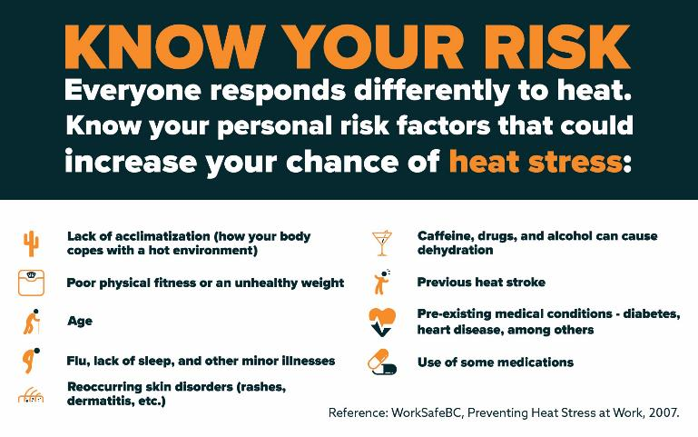
Notes:
This slide contains an overview of the personal risk factors for heat stress. Each worker should understand their own level of risk and it is important for supervisors to also be mindful of workers who may be at higher risk.

Slide 19
Heat Stress Management
Heat stress policy (or sun safety policy)
Heat stress program or hot weather plan (could be part of a sun safety program):
Risk assessment process
Control measures: general controls and job specific controls
Training and education of workers
Incident response, reporting and investigation including first aid
‘Check’ elements: workplace inspections, annual audits, documentation
Notes:
This slide points at employer due diligence systems for managing heat stress and that the supervisor has a role in this system which supports their duty to protect workers
A heat stress program/hot weather plan/sun safety program is built on a heat stress/sun safety policy. The program/plan included the elements listed above. Supervisors have a role in each of the elements.

Slide 20
Heat Stress Risk Assessment
Operational Review: to gain an understanding of the operational environment and risk factors for heat stress
Job Safety Analysis: for specific positions/tasks which may have elevated risk
Daily Assessment: during summer, assessment undertaken when pre-determined trigger values are reached (for example, humidex = 30ºC, Environment Canada Heat Advisory’s):
WBGT (web bulb globe temperature) assessed using ‘heat stress monitor’ or humidex assessed using ‘thermal hygrometer’
Adjustments for clothing, radiant heat, work rate, work/rest cycle
Need a monitoring plan: who, where, when, how
Notes:
We suggest that a three level/layered approach to assessing heat stress for outdoor workers is undertaken. We have a range of tools to assist a workplace in undertaking these risk assessment processes.
This is the front end, the assessment process either initial, annual or daily. Spend some time here outlining our tools for these assessment steps.
A supervisor is most likely to be involved in the daily assessment of either WBGT or humidex, and then in implementing the resultant response actions.

Slide 21
General Control Measures
Provide heat stress information and training through verbal and written instructions, annual heat stress training, orientation training, safety talks, etc
Encourage workers to keep hydrated: drink 1 cup of water every 20 minutes
Workers to report symptoms of heat stress
Encourage self-limitation of exposure when supervisor is not present
Workers to look out for signs and symptoms of heat stress in co-workers
Additional training for high risk workers
Encourage healthy lifestyles
Notes:
Point out our training presentations.
Point out once again the need to watch out for each other.

Slide 22
Humidex 1:
Unacclimatized, moderate work rate
Acclimatized, heavy work rate
Humidex 2:
Unacclimatized, light work rate
Acclimatized, moderate work rate
Notes:
The response action listed are for when a workplace is undertaking their daily assessment using humidex (and not when using WBGT).
Humidex 1 response action humidity levels are for un-acclimatized workers at a moderate work rate or acclimatized workers at a heavy work rate.
Humidex 2 action humidity levels are for un-acclimatized workers working only at a light work rate or acclimatized workers at a moderate work rate.
Moderate and heavy work rates are defined to a great extent in our technical guide.
Note that these response actions are taken in response to specific humidex values which can vary throughout a day and vary across locations. As such, there is a need for ongoing monitoring of humidex values through a high humidex day to ensure that the appropriate response actions are being taken (e.g. if the humidex rises then additional/new response actions may be necessary). Our ‘Heat Stress Alert’ and Heat Stress Warning’ posters have been designed to assist a workplace in making their outdoor workers aware of the actions to take at different humidex values.
Remind Supervisors that these are guidelines only and their due diligence applies in every situation.

Slide 23
Job Specific Control Measures
Provide barriers to shield workers from radiant heat exposure.
Provide cooling fans when air temperature is below skin temperature (35°C) and the humidity is below 70%. Above these levels causes more heating.
Consider cooling or dehumidifying the workplace.
Provide mechanical aids for material handling — dollies, carts, lifting devices — to reduce physical activity. Organize the work to reduce the pace of activity.
Notes:
Examples. Workplaces need to adapt to their own specific needs so get thinking “outside the box”.
We can implement (slowly if needed) things we know about and things we think about in the course of our work (ideas).

Slide 24
Job Specific Control Measures
If possible, postpone strenuous work until a cooler time of the day.
If work is done outside, ensure that shaded areas are available.
Rotate workers in and out of hot work areas whenever possible.
Consider cooling vests, if feasible and effective for the worker.

Slide 25
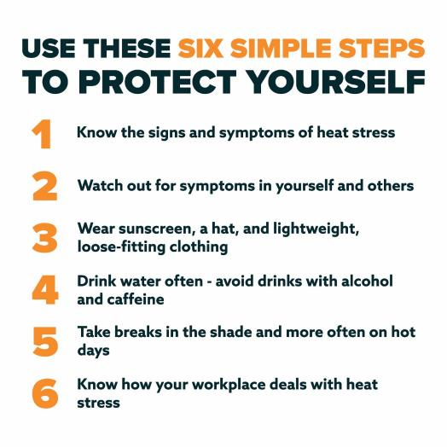
Protection Measures Workers Should Take
Notes:
The steps listed are designed for workers to take to help protect themselves from heat stress.
1. Be aware of the signs and symptoms as covered in this training
2. Be aware of how yourself and others are tolerating the heat
3. Personal protection is an important control measure and this also assist in controlled solar UV exposure
4. Keeping hydrated is probably the most important heat stress control measure an individual can take
5. Taking breaks in the shade or working in the shade when possible are both important ways to regulate heat stress for outdoor workers
6. Refer to your organization’s heat stress policy and program/hot weather plan if one has been developed.

Slide 26
Resources (available at sunsafetyatwork.ca)
Posters: heat stress prevention, heat stress alert, heat stress warning
Fact sheets: heat stress prevention, heat stress signs and symptoms, shade, reflective surfaces, personal protection, acclimatization, work/rest cycles, off-the-job sun safety, sun safety programs, legal issues
Training: presentations for workers, safety talks, videos, personal risk assessments, training guide, video worksheet
Risk assessment: technical guide, operational review, daily monitoring plan, daily assessment record
Daily procedures: heat stress assessment for humidex and WBGT
Inspection checklist, investigation report template
Example policies, example role and responsibilities
Notes:
The Sun Safety at Work Canada project has developed a range of resources which are available for download and use by workplaces. These are available from the project’s website: www.sunsafetyatwork.ca

Slide 27
References
Luginbuhl, RC, Jackson LL, Castillo DN, Loringer KA. (2008). Heat-related deaths among crop workers - United States, 1992-2006. MMWR Morbidity and Mortality Weekly Report, 57, 647-653.

Slide 28
Thank you!
Production of this presentation has been made possible through financial support from Health Canada through the Canadian Partnership Against Cancer.
Thank you to all of the partners who made this project a success:

